Slide 1
ENERGY ZAPS,
FREAK OUTS AND BEFUDDLED BRAINS
Dr Stacey Francis

Slide 2
Dr Stacey Francis
Chiropractic Kinesiologist
Functional Medicine Practitioner
Public Speaker
Published Author of The Supercharged Method: Your Transformation from Fatigued to Energized!
www.specificwellness.com

Slide 3
ENERGY ZAPS!
"I'm so tired!!

Slide 4
Raise your hand if you skip meals but then feel like eating your face off

Slide 5
When your blood sugar drops too low it puts a lot of stress on your brain.
Your brain uses 20% of all the energy your body makes; it requires more energy (blood sugar) than any other organ in your body.
It is also the first organ to suffer when blood sugar drops.

Slide 6
Skipping meals triggers danger/stress to the primative brain.
The primative brain hijacks the evolved brain and has you reach for quick fuel.

Slide 7
Quick Carbs stimulate dopamine (the reward center in your brain)
which, in turn, makes you reach for more carbs

Slide 8
We aren't addicted to carbs,
we are addicted to dopamine

Slide 9
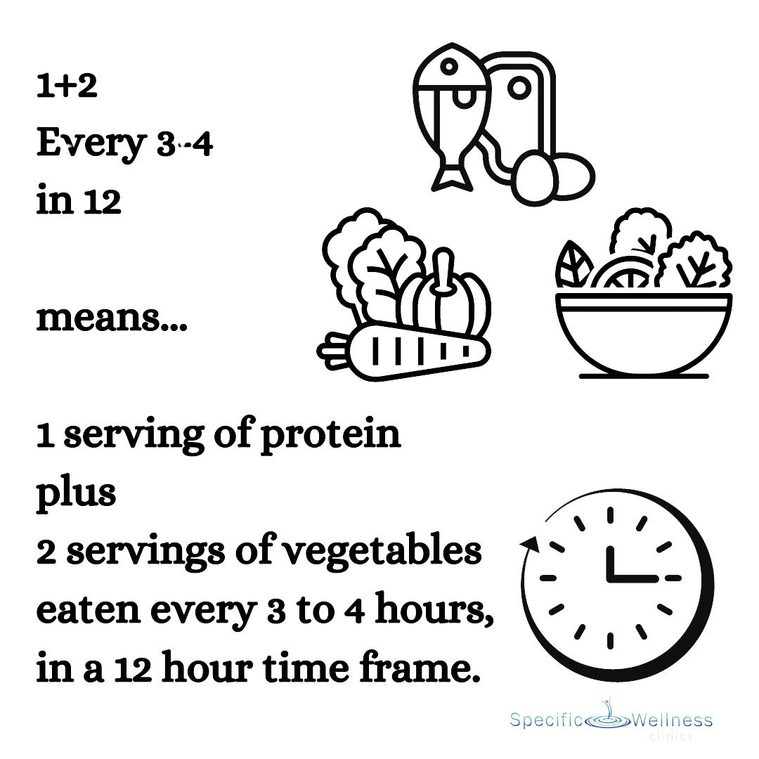
Solution: The Supercharged Method
Eliminate blood sugar imbalance, increase fiber and nutrients & lower inflammation

Slide 10
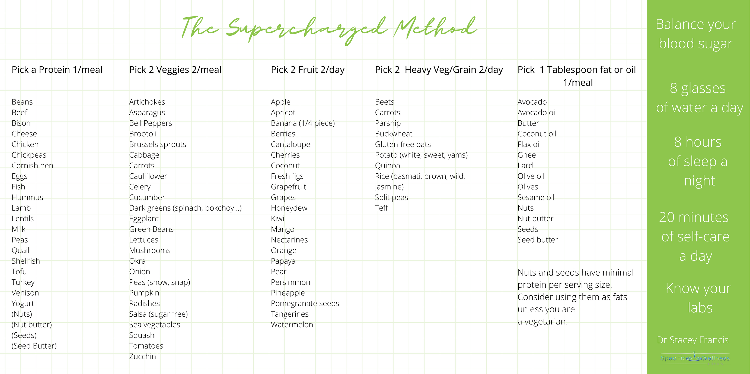
Iron-rich food
B Vitamin-rich food

Slide 11
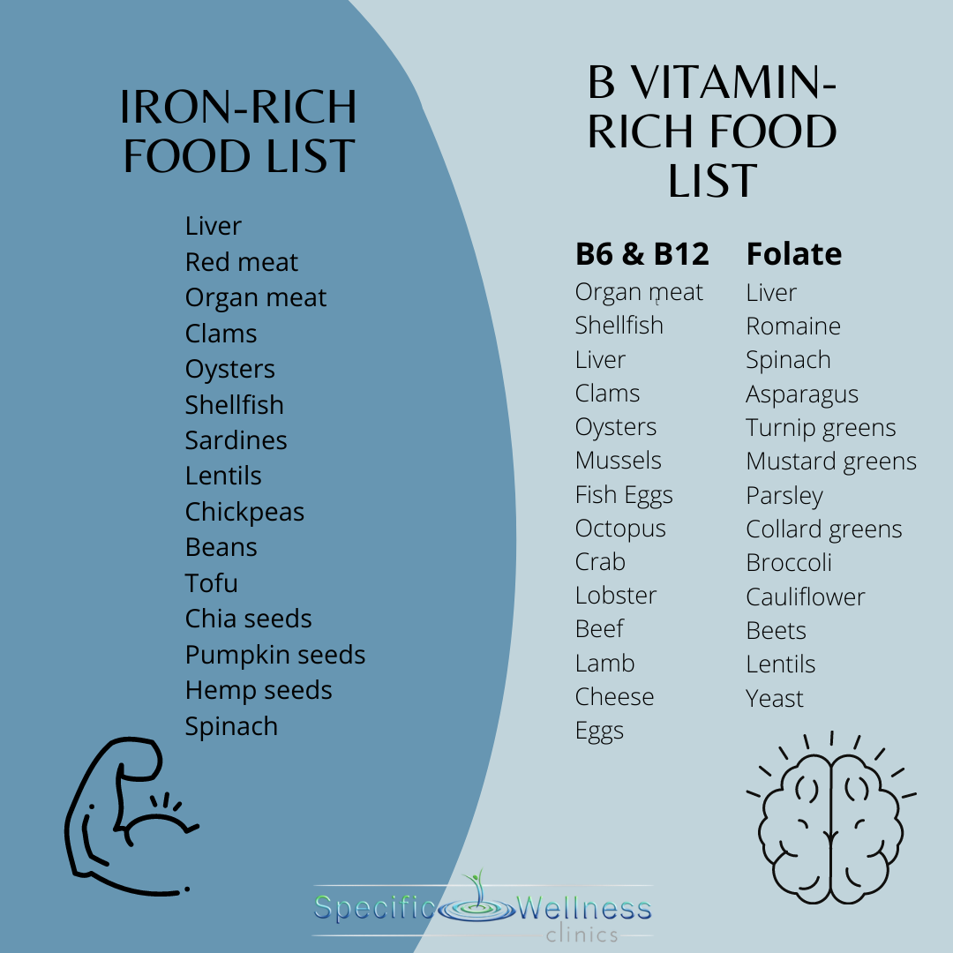

Slide 12
FREAK OUTS
"I'm totally stressed!"
Notes:
Charging Rhino vs deadline
parasympathetic to sympathetic
Chronic sympathetic state is a toll on the adrenal glands.
Can't avoid trauma that happens to you but we can control the reaction we have to it to some extent and use our frontal lobe to allow access to tools to bring us back to a parasymp state.

Slide 13
Let's Start with the Brain
When you have stress or anxiety three parts of your brain are involved

Slide 14
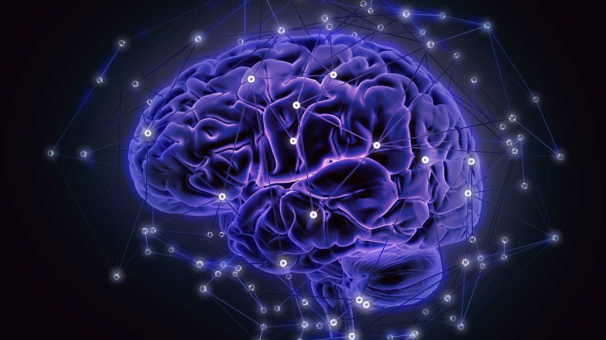
Emotional brain
(limbic system)
You have a thought then you have a feeling about that thought
Control your thoughts to control your feelings
Evolved frontal brain
Healhty choices come from here
Primative brain
Survival

Slide 15
Your primal brain can't tell the difference between a charging rhino and a midterm exam

Slide 16
Unprocessed emotions
Stress
Seeking comfort
Looking for a
dopamine hit
Manage
Over Eating
Flour/Sugar
Caffeine
Video Games
Scrolling
Avoid
Alcohol
Vaping
Smoking
Drugs

Slide 17
Processing Emotion
Being present with the vibrations in our body and not running from them or being reactive.
Feel Your Feelings

Slide 18
Why Zebras Don't Get Ulcers

Slide 20
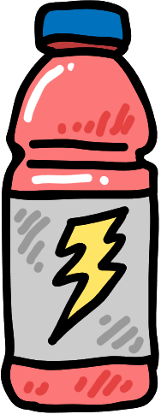
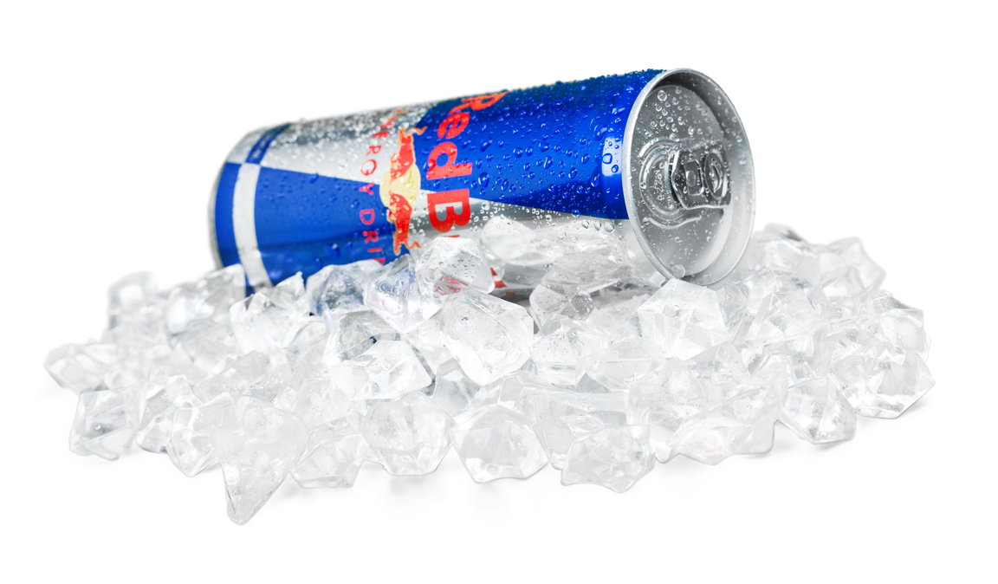
Drink
1/2 of your body weight
in ounces of water a day
Optimal hydration & detoxification
Solution:
The
Supercharged Method:
DRINK

Slide 21
Spend at least
20 minutes a day in tranquility
Move from Sympathetic to Parasympathetic State
Solution:
The
Supercharged Method:
CHILL

Slide 22
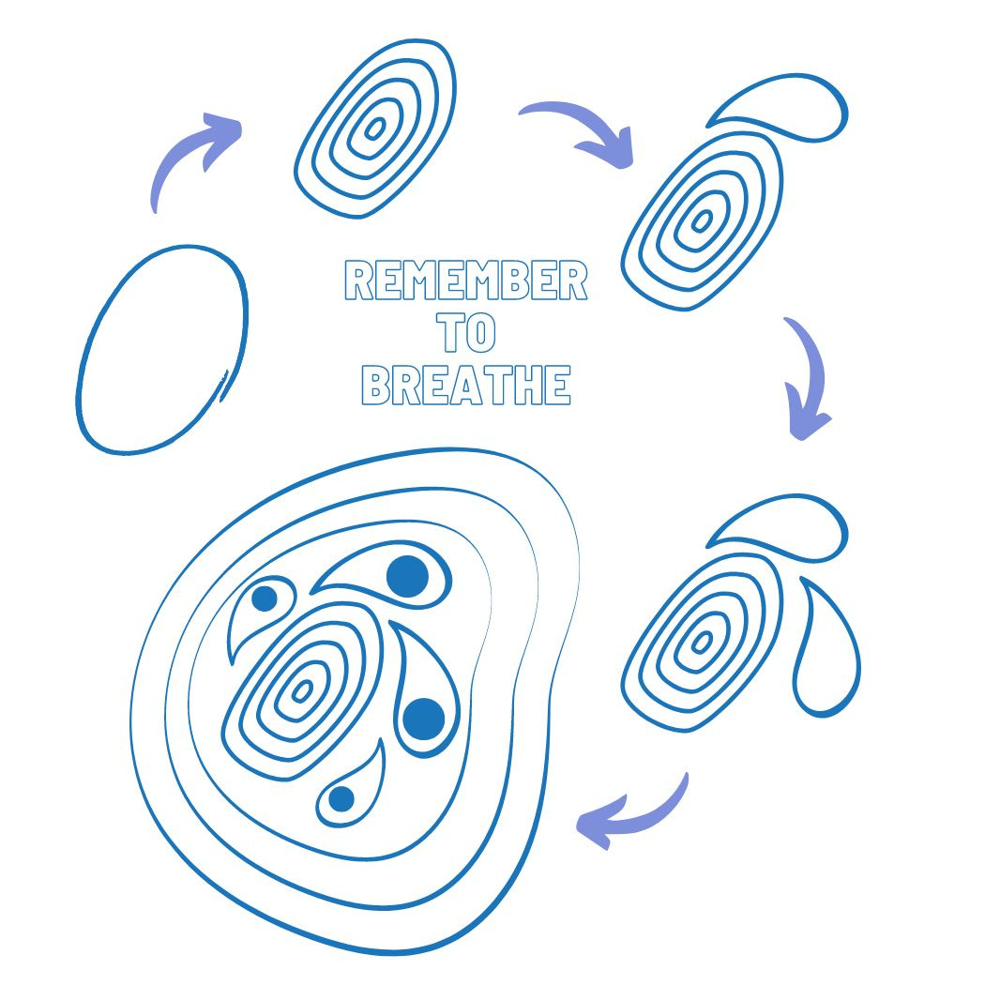

Slide 23
Solution:
The
Supercharged Method:
SLEEP
Get 6-9 hours of good sleep every night
Restoration & Recovery

Slide 24
SLEEP BETTER
Relax before bed (read, draw, walk)
Dark room
White noise
Lavendar essential oil
Avoid caffeine after 2pm
Avoid electronics before bed
Brain dump

Slide 25
BEFUDDLED BRAIN
"Why can't I focus?"

Slide 26
Raise your hand if you eat, scroll, video game (insert other behavior here) when you are angry, lonely, sad, tired, frustrated, bored, procrastinating...

Slide 27
If you are low in iron you cannot concentrate.
Test Ferritin
Eat food rich in iron
Konofal E, Lecendreux M, Arnulf I, Mouren M. Iron Deficiency in Children With Attention-Deficit/Hyperactivity Disorder. Arch Pediatr Adolesc Med. 2004;158(12):1113–1115. doi:10.1001/archpedi.158.12.1113

Slide 28
A new study found that brain inflammation in people who were experiencing clinical depression was increased by
30 per cent.

Slide 29
Stress can cause inflammation

Slide 30
Chronic Stress
Brain Inflammation
Depression
Test C-Reactive Protein (CRP)

Slide 31
A poor diet can cause inflammation

Slide 32
Study finds Vitamin B9 (Folic acid/Folate) treatment associated with reduced risk of suicide and self harm by
44%

Slide 33
988
CALL, TEXT OR CHAT

Slide 35
Buy the book:
Work with me!
WWW.SPECIFICWELLNESS.COM
INFO@SPECIFICWELLNESS.COM
248-213-1332

